Slide 1
Bayes Theorem and
Naïve Bayes Classifier

Slide 2
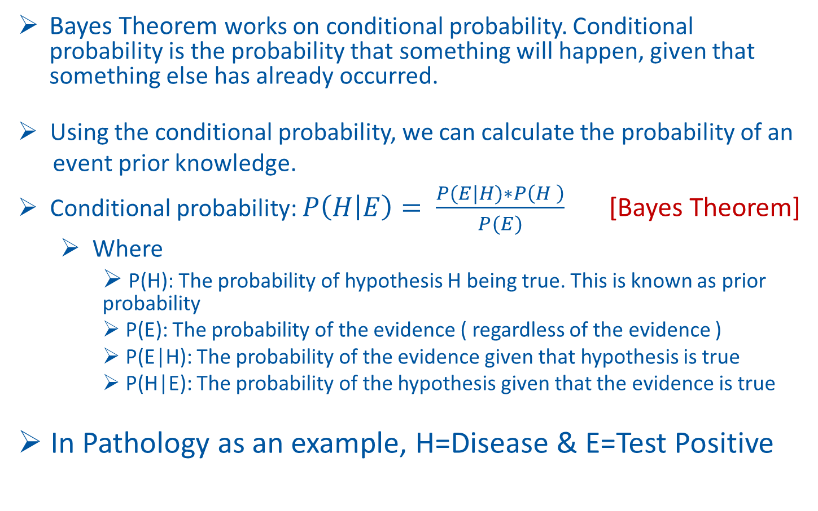
Bayes Theorem
Bayes Theorem works on conditional probability. Conditional probability is the probability that something will happen, given that something else has already occurred.
Using the conditional probability, we can calculate the probability of an
event prior knowledge.
Conditional probability: $P\left(H | E\right)= \frac{P(E|H)∗P\left(H \right)}{P(E)}$ [Bayes Theorem]
Where
P(H): The probability of hypothesis H being true. This is known as prior probability
P(E): The probability of the evidence ( regardless of the evidence )
P(E|H): The probability of the evidence given that hypothesis is true
P(H|E): The probability of the hypothesis given that the evidence is true
In Pathology as an example, H=Disease & E=Test Positive

Slide 3
Example Problem
A Path Lab is performing a Test for a disease say “D” with two results “Positive” & “Negative”
They guarantee that their test result is 99% accurate:
If patient has the disease, they will give test positive 99% of the time.
If patient does not have the disease, they will test negative 99% of the time.
It is given that 3% of all the people have this disease
New patient goes to Path Lab for test and his test gives “positive” result
What is the probability that New Patient actually has the disease?
How doctors can use this information in their inferences?

Slide 4
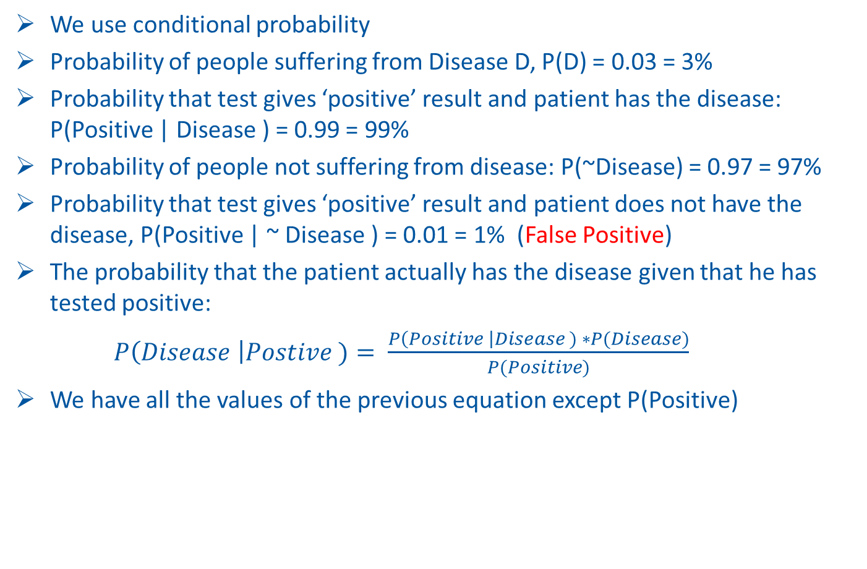
Answering the problem
We use conditional probability
Probability of people suffering from Disease D, P(D) = 0.03 = 3%
Probability that test gives ‘positive’ result and patient has the disease: P(Positive | Disease ) = 0.99 = 99%
Probability of people not suffering from disease: P(~Disease) = 0.97 = 97%
Probability that test gives ‘positive’ result and patient does not have the disease, P(Positive | ~ Disease ) = 0.01 = 1% (False Positive)
The probability that the patient actually has the disease given that he has tested positive:
$P\left(Disease \right|Postive )= \frac{P\left(Positive \right|Disease ) ∗P(Disease)}{P(Positive)}$
We have all the values of the previous equation except P(Positive)

Slide 5

Answering the problem
$P\left(Positive\right)=P\left(D∩Positive \right)+P(\left( \sim D\right)∩Positive))$
$$=P\left(Positive | D \right)∗P\left(D\right)+P\left(Positive | (\sim D) \right)∗P\left(\sim D\right)=0.99∗0.03+0.01∗0.97 =0.0297+0.0097 =0.0394$$

Slide 6
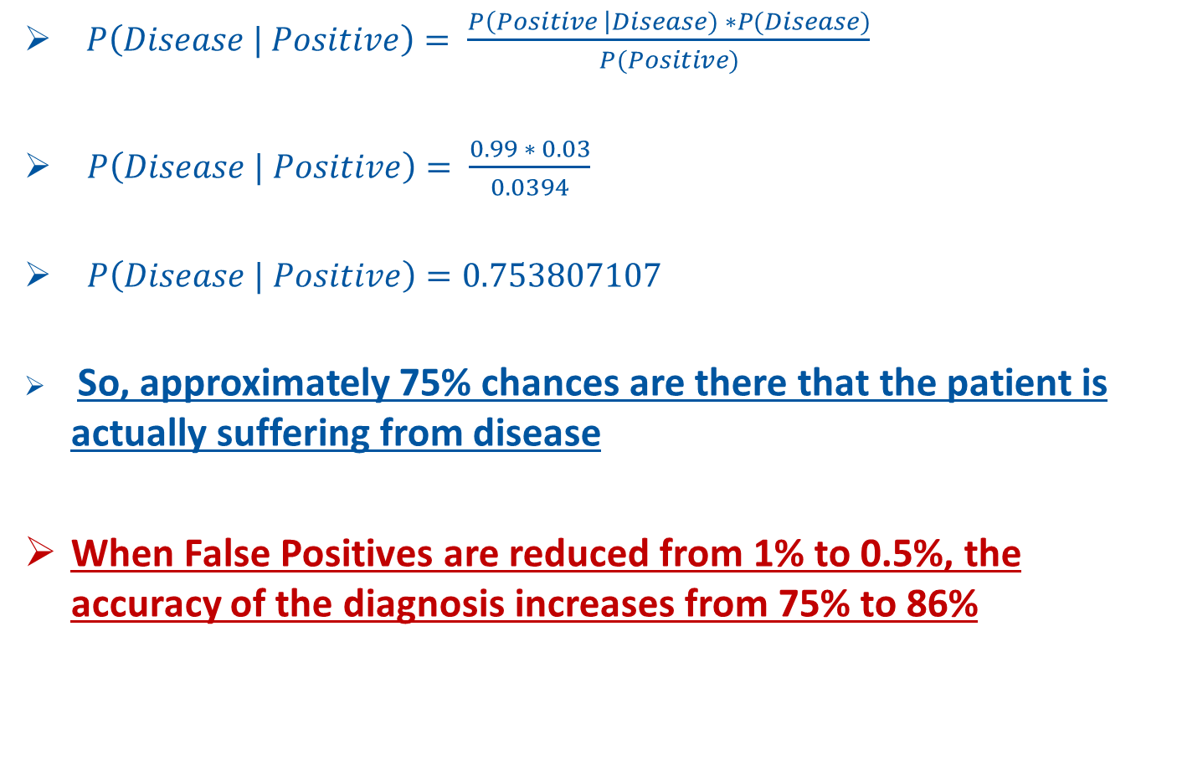
Answering the problem
$P\left(Disease | Positive\right)= \frac{P\left(Positive \right|Disease) ∗P(Disease)}{P(Positive)}$
$P\left(Disease | Positive\right)= \frac{0.99 ∗ 0.03}{0.0394}$
$P\left(Disease | Positive\right)=0.753807107$
So, approximately 75% chances are there that the patient is actually suffering from disease
When False Positives are reduced from 1% to 0.5%, the accuracy of the diagnosis increases from 75% to 86%

Slide 7
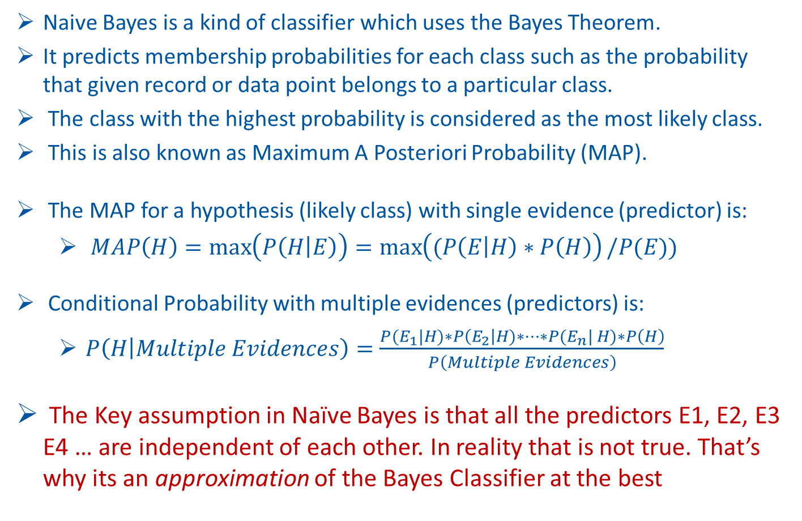
Naïve Bayes:
an Approximate Bayes Classifier
Naive Bayes is a kind of classifier which uses the Bayes Theorem.
It predicts membership probabilities for each class such as the probability that given record or data point belongs to a particular class.
The class with the highest probability is considered as the most likely class.
This is also known as Maximum A Posteriori Probability (MAP).
The MAP for a hypothesis (likely class) with single evidence (predictor) is:
$MAP\left(H\right)=\max\left(P\left(H | E\right)\right)=\max\left((P\left(E | H\right)∗P\left(H\right)\right)/P(E))$
Conditional Probability with multiple evidences (predictors) is:
$P\left(H | Multiple Evidences\right)=\frac{P(E_{1}|H)∗P\left(E_{2}\right|H)∗⋯∗P(E_{n}| H)∗P\left(H\right)}{P\left(Multiple Evidences\right)}$
The Key assumption in Naïve Bayes is that all the predictors E1, E2, E3 E4 … are independent of each other. In reality that is not true. That’s why its an approximation of the Bayes Classifier at the best

Slide 8
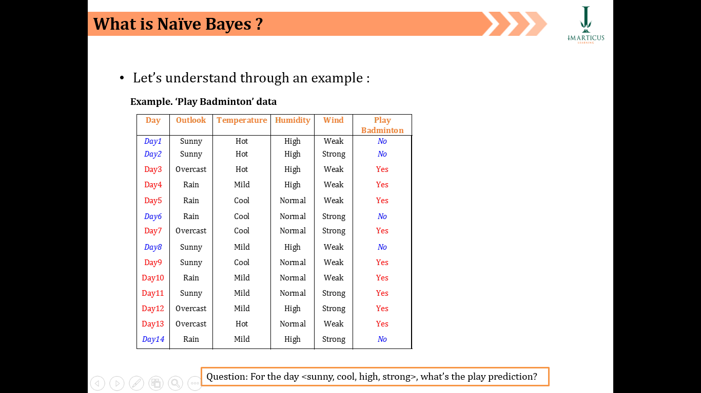

Naïve Bayes Classification: Example
Let’s Understand Through an Example: Play Badminton Data
Question: For the day <sunny, cool, high, strong>, what’s the play prediction?

Slide 9
The Model Training Phase
For four external factors, for each factor we calculate the conditional probability ’s table
P(Play=No) = 5/14
P(Play=Yes) = 9/14

Slide 10
The Model Training Phase
Learning Phase
Outlook | Play=Yes | Play=No
Sunny | 2/9 | 3/5
Overcast | 4/9 | 0/5
Rain | 3/9 | 2/5
Temperature | Play=Yes | Play=No
Hot | 2/9 | 2/5
Mild | 4/9 | 2/5
Cool | 3/9 | 1/5
Humidity | Play=Yes | Play=No
High | 3/9 | 4/5
Normal | 6/9 | 1/5
Wind | Play=Yes | Play=No
Strong | 3/9 | 3/5
Weak | 6/9 | 2/5
P(Play=Yes) = 9/14
P(Play=No) = 5/14

Slide 11
The Model Test Phase
Test Phase
Given a new instance, predict its label
x’=(Outlook=Sunny, Temperature=Cool, Humidity=High, Wind=Strong)
Look up tables achieved in the learning phrase
P(Outlook=Sunny|Play=Yes) = 2/9
P(Temperature=Cool|Play=Yes) = 3/9
P(Humidity=High|Play=Yes) = 3/9
P(Wind=Strong|Play=Yes) = 3/9
P(Play=Yes) = 9/14
P(Outlook=Sunny|Play=No) = 3/5
P(Temperature=Cool|Play==No) = 1/5
P(Humidity=High|Play=No) = 4/5
P(Wind=Strong|Play=No) = 3/5
P(Play=No) = 5/14

Slide 12
The Model Test Phase
Test Phase
Given a new instance, predict its label
x’=(Outlook=Sunny, Temperature=Cool, Humidity=High, Wind=Strong)
Decision making with the MAP rule
P(Yes|x’) ≈ [P(Sunny|Yes)P(Cool|Yes)P(High|Yes)P(Strong|Yes)]P(Play=Yes)
= 0.0053
P(No|x’) ≈ [P(Sunny|No) P(Cool|No)P(High|No)P(Strong|No)]P(Play=No)
= 0.0206
Given the fact P(Yes|x’) < P(No|x’), we label x’ to be “No”.

Slide 13
Advantages and Disadvantages
Advantages
Naïve Bayes Algorithm is a fast, highly scalable algorithm
Naïve Bayes can be used for Binary and Multiclass classification
It provides different types of Naïve Bayes Algorithms like GaussianNB, MultinomialNB, BernoulliNB
It is a simple algorithm that depends on doing a bunch of counts
It is a popular choice for spam email classification
Disadvantages
It considers all the features to be unrelated

